Slide 1

Time Series Prediction of the NAO Index
Janika Rhein, Dikshyant Acharya, Tetiana Prykhodko and Ludwig Meder
10.07.2024

Slide 2
Outline - delete later on
What is the North Atlantic Oscillation (NAO)
Definition, both ways to calculate it
Importance (impact on society) -> motivation for prediction
Available forecasts, maybe machine learning approaches
Data
time series characteristics: monthly/daily
showing them with example weather state
Our approaches
monthly time series
our models
daily time series
our models
Conclusion
Monthly data - not good (no former literature)
Daily data - better -> maybe best with rolling window approach

Slide 3
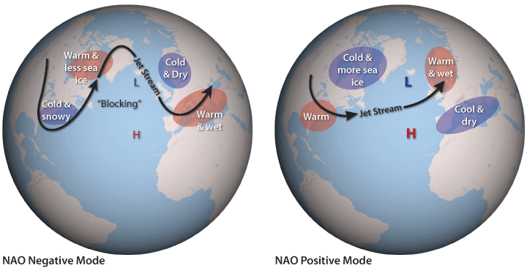
The North Atlantic Oscillation (NAO)
Pressure difference between Azores High and Icelandic Low
3 Phases:
Positive: Strongly developed pressure systems
Neutral: One pronounced pressure system
Negative: Low pressure difference or turn of signs
https://www.climate.gov/media/5522

Slide 4
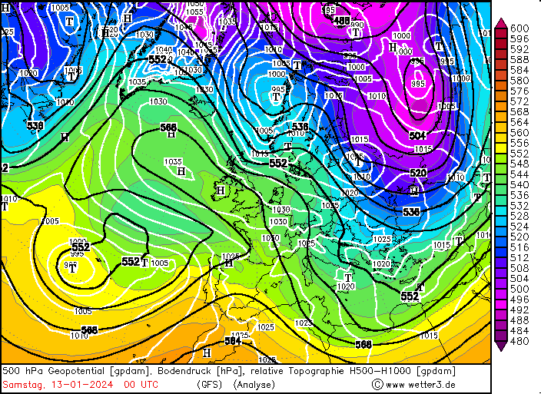
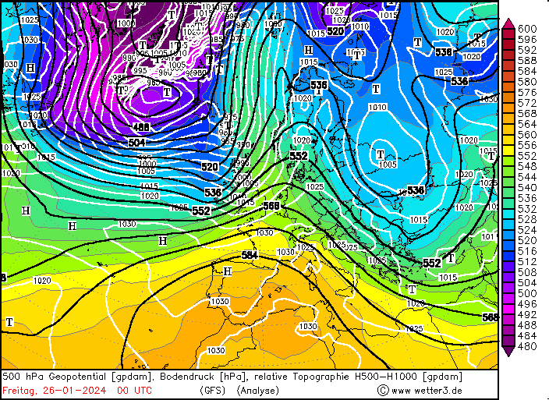
NAO - Implications: An Example
NAO- 13.01.24: -3.93
NAO+ 26.01.24: + 3.07

Slide 5
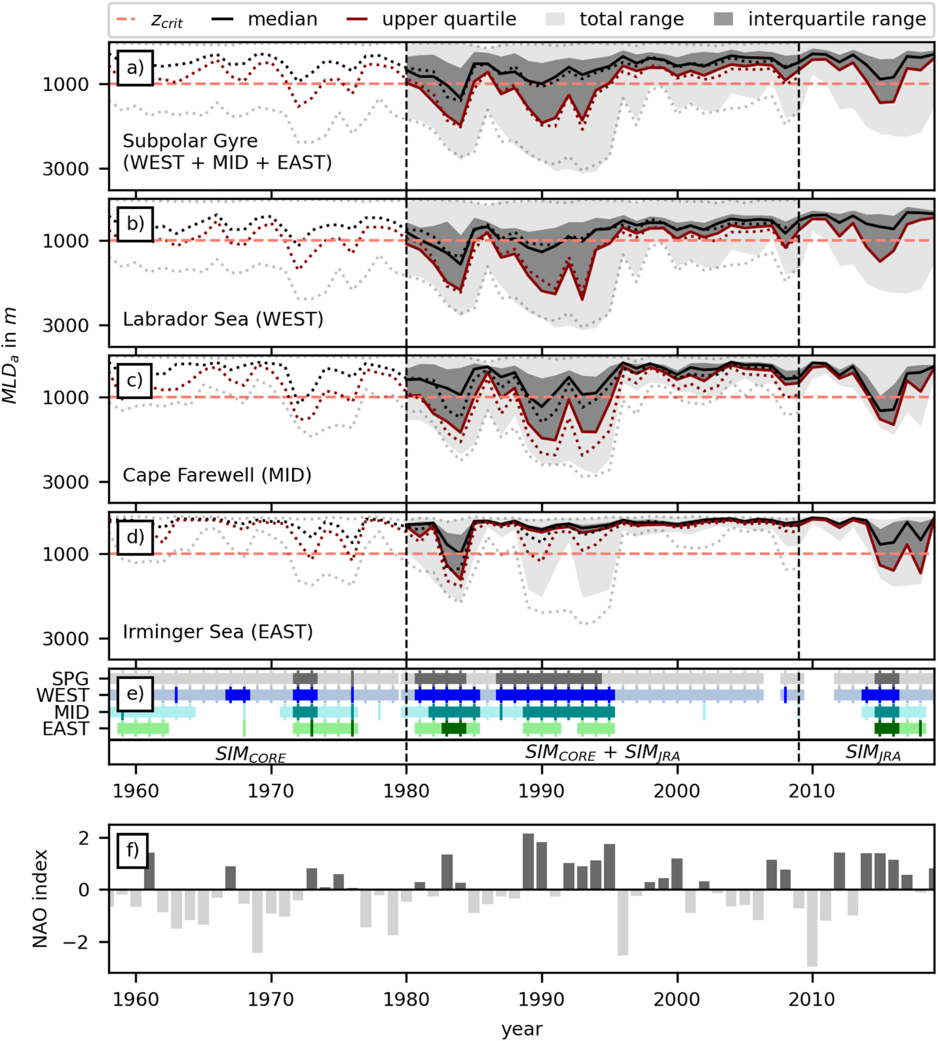
NAO - Implications
European (North American) Weather
temperature and precipitation
heat waves/ cold spells
Deep Convection
-> large scale ocean circulation
Rühs et al. (2019)

Slide 6
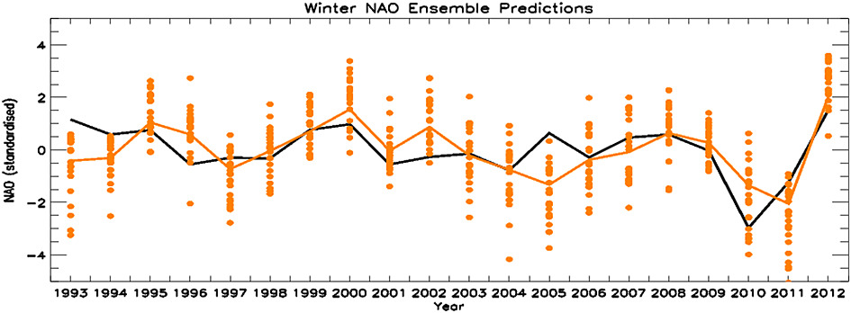
NAO - Numerical Forecast Example
GloSea5 (based on HadGEM3)
atm: 0.85°x0.55° (lon x lat), 85 vertical levels
ocean: 0.25°, 75 vertical levels
24 ensemble member
Scaife et al. (2014)

Slide 7
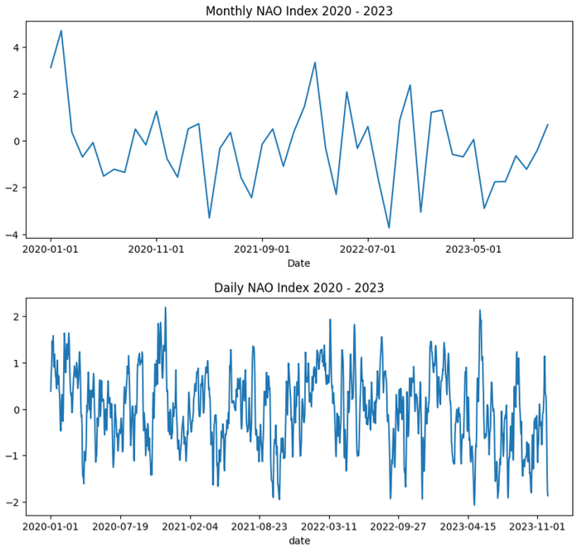
Data
Monthly Dataset:
1825 - 2023
SLP’ Azores - SLP’ Iceland
Daily Dataset:
01.01.1950 - 12.05.2024
based on the first (rotated) Principal Component/EOF
SLP’: Normalised Pressure Anomaly
Notes:
Monthly Data:
(SLP - mean of reference period)/standard deviation of reference month;
SLP’ Azores - SLP’ Iceland
period: 1825 - 2023
Daily Data:
different calculated -> based on principle components -> less noisy
period: 01.01.1950 - 12.05.2024
https://www.cpc.ncep.noaa.gov/products/precip/CWlink/pna/nao.shtml

Slide 8
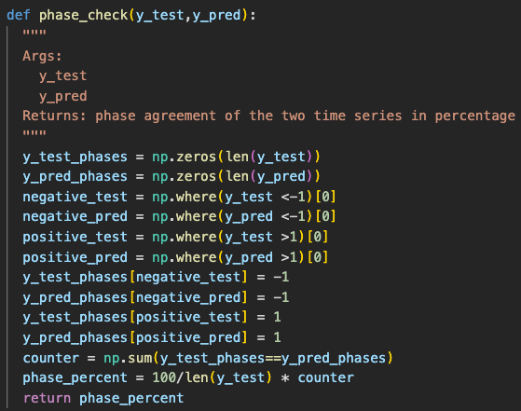
Evaluation Metrics
Mean Squared Error
Mean Absolute Error
Median Absolute Error
Phase Percentage

Slide 9
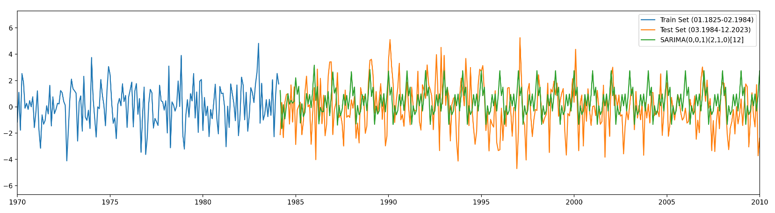
Baseline: SARIMA
monthly dataset
80% for training, 20% for testing/predicting
-> 478 months forecast
SARIMA(0,0,1)(2,1,0)[12]
Metrics for Testset:
MSE: 4.01
Phase Percent: 38.08%

Slide 10
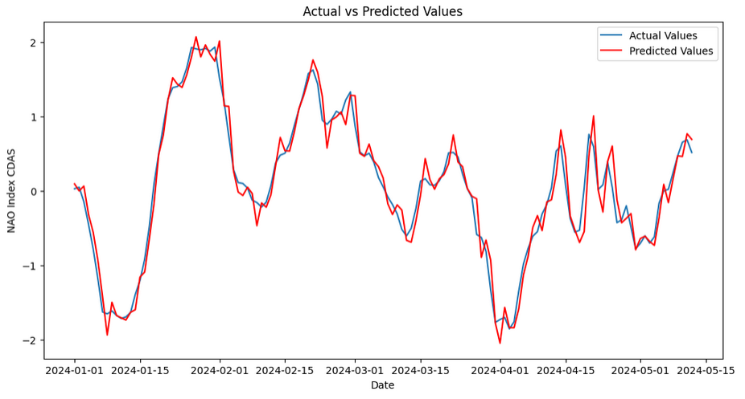
Baseline: ARIMA
daily dataset
1950-2024 -> Training
2024- 05.2024 -> Validation
60 Data to predict 1 data
Metrics for Validation Set:
MAE: 0.14

Slide 11
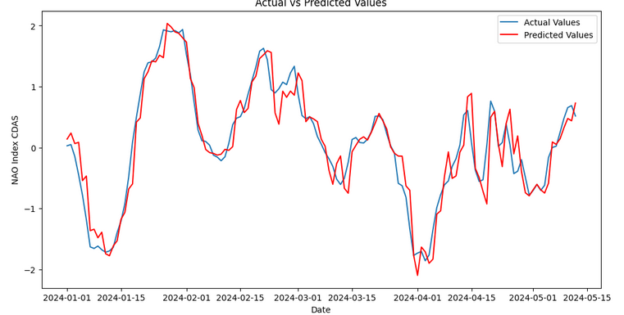
ARIMA
daily dataset
1950-2024 -> Training
2024- 05.2024 -> Validation
100 Data to predict 2 data
Metrics for Validation Set:
MAE: 0.2

Slide 12
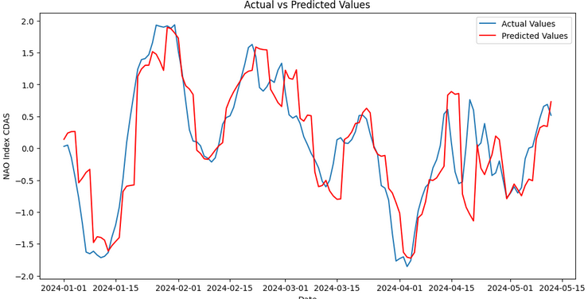
ARIMA
daily dataset
1950-2024 -> Training
2024- 05.2024 -> Validation
100 Data to predict 4 data
Metrics for Validation Set:
MAE: 0.36

Slide 13
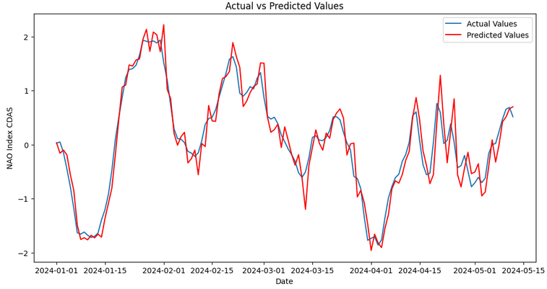
SARIMA
daily dataset
1950-2024 -> Training
2024- 05.2024 -> Validation
60 Data to predict 1 data
Metrics for Validation Set:
MAE: 0.19

Slide 14
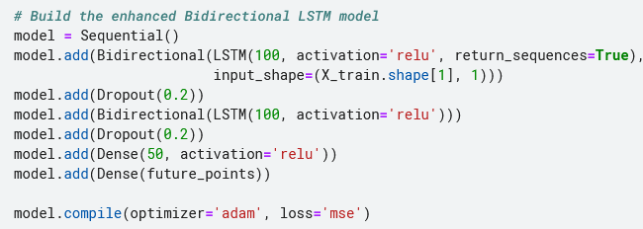
LSTM
daily dataset
1950-2024 -> Training
2024- 05.2024 -> Validation
50 Data to predict 1 data

Slide 15
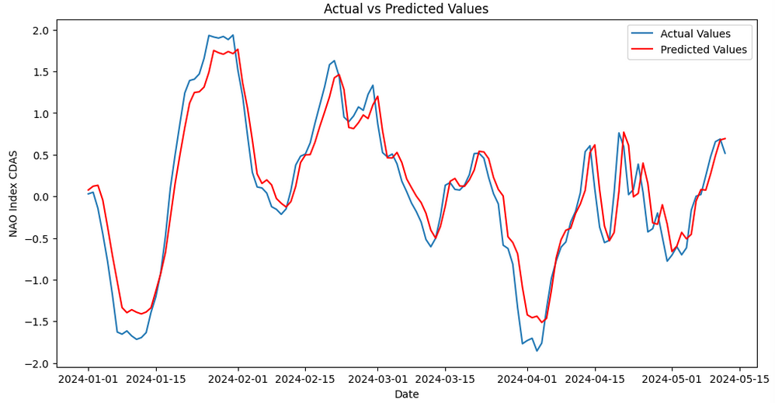
LSTM
daily dataset
1950-2024 -> Training
2024- 05.2024 -> Validation
60 Data to predict 1 data
Metrics for Validation Set:
MAE: 0.18

Slide 16
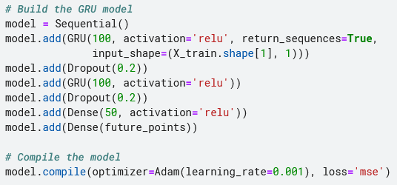
GRU
daily dataset
1950-2024 -> Training
2024- 05.2024 -> Validation
60 Data to predict 1 data

Slide 17
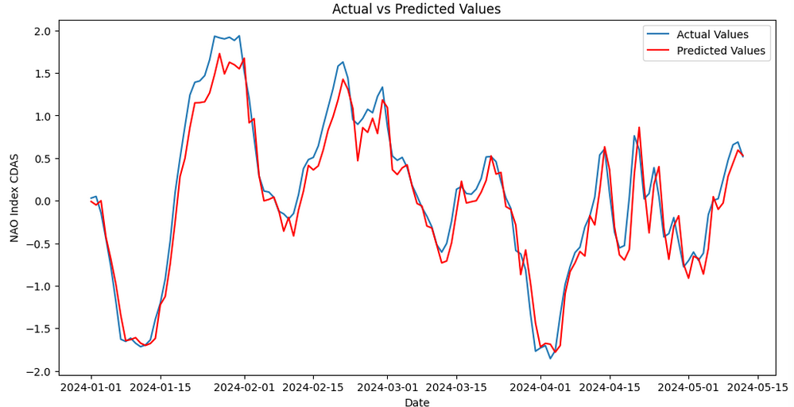
GRU
daily dataset
1950-2024 -> Training
2024- 05.2024 -> Validation
60 Data to predict 1 data
Metrics for Validationset:
MAE: 0.18

Slide 18
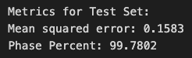
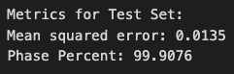
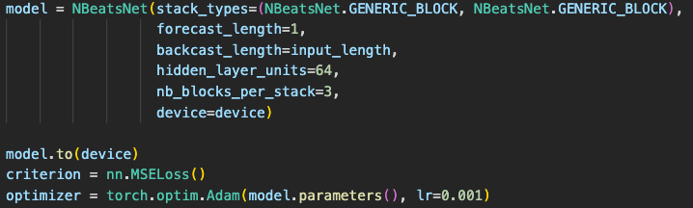
NBeatsNet with monthly / daily data
Monthly
24 data to predict one entry
epochs: 50
learning rate: 0.001
training / val / test = 60 / 20 / 20
Daily

Slide 19
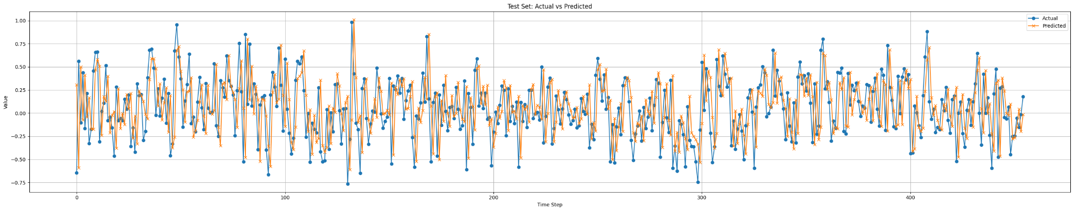
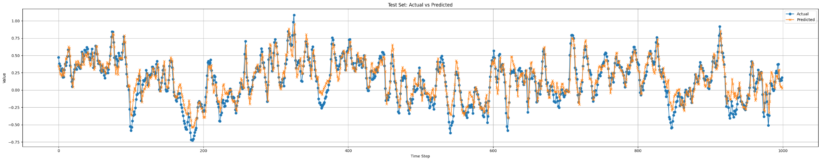
NBeatsNet with monthly data
NBeatsNet with daily data (section of 1000 days)

Slide 20
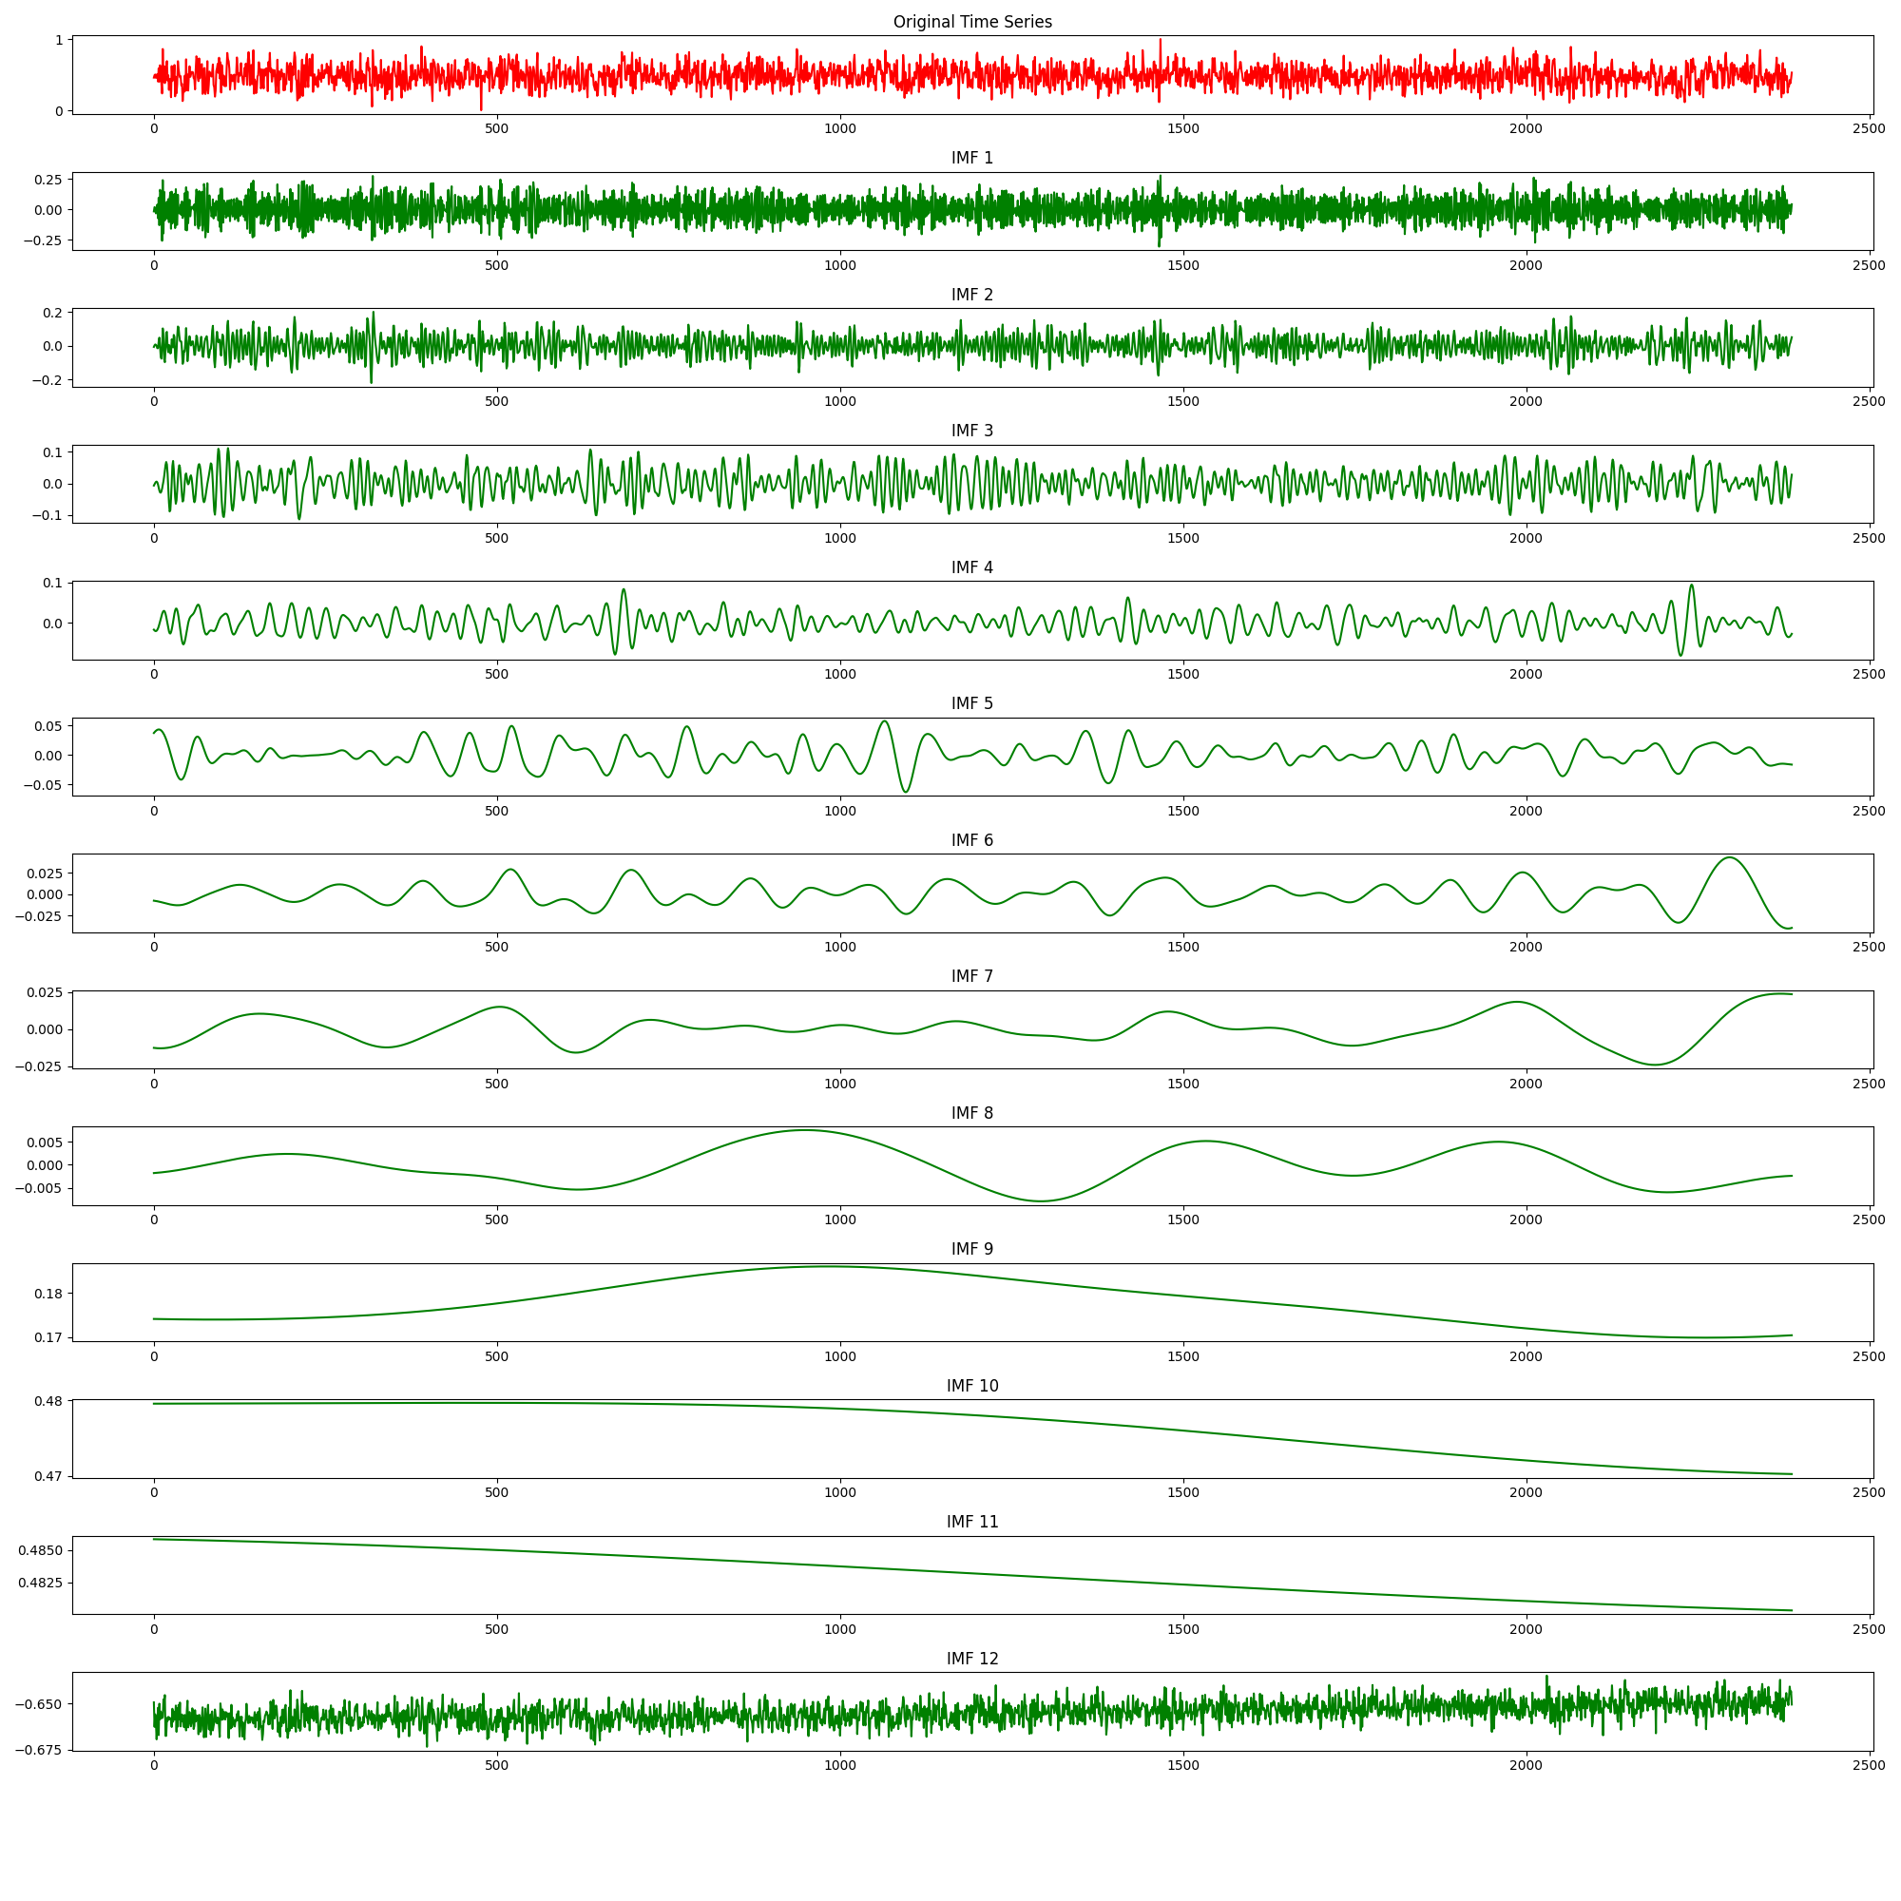
EEMD and XGBoost
ensemble empirical mode decomposition
decomposes TS in intrinsic mode functions (IMFs) and residuals
increases model performance!

Slide 21
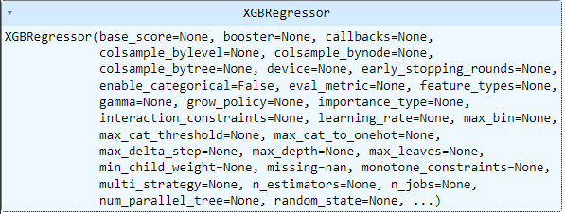
EEMD and XGBoost
24 months to predict 1
fine tuning did not improve the model…
Metrics for Testset:
MSE: 1.22
Phase Percent: 70.55%

Slide 22
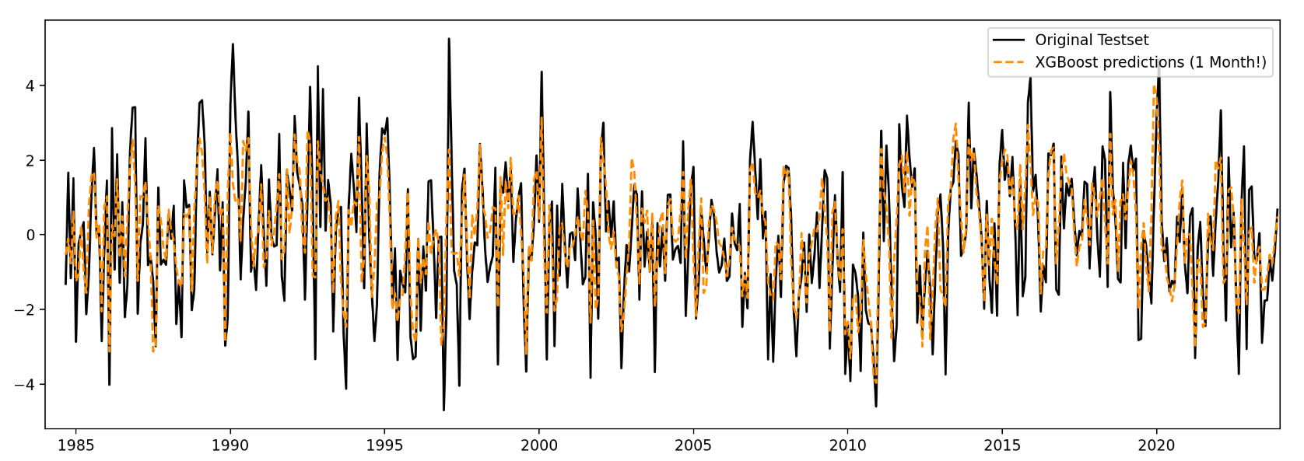
EEMD and XGBoost

Slide 23
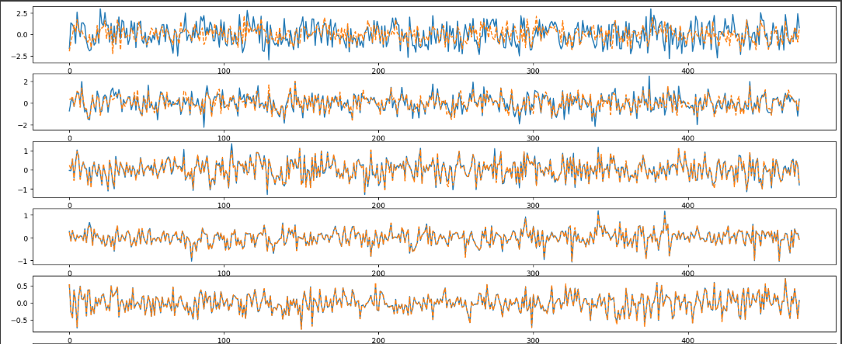
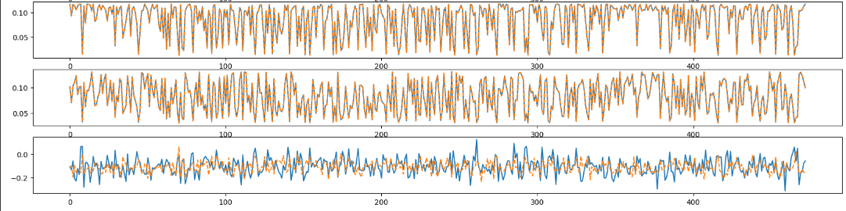
EEMD and XGBoost
IMF1
IMF2
IMF3
IMF4
IMF5
IMF10
IMF11
Residuals
…

Slide 24
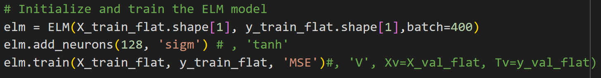
Extreme Learning Machine (ELM) with daily data
ELM:
one hidden layer
weights and biases: randomly assigned
extreme fast training process due to least-square solutions of output weights
20 days to predict one
MSE: 0.04, MAE: 0.16, Phase Ratio: 91.6%

Slide 25
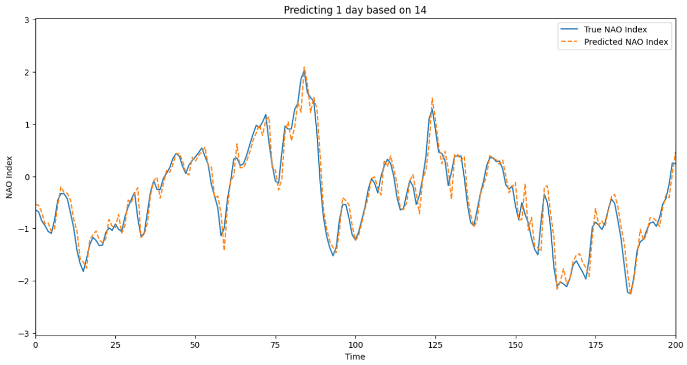
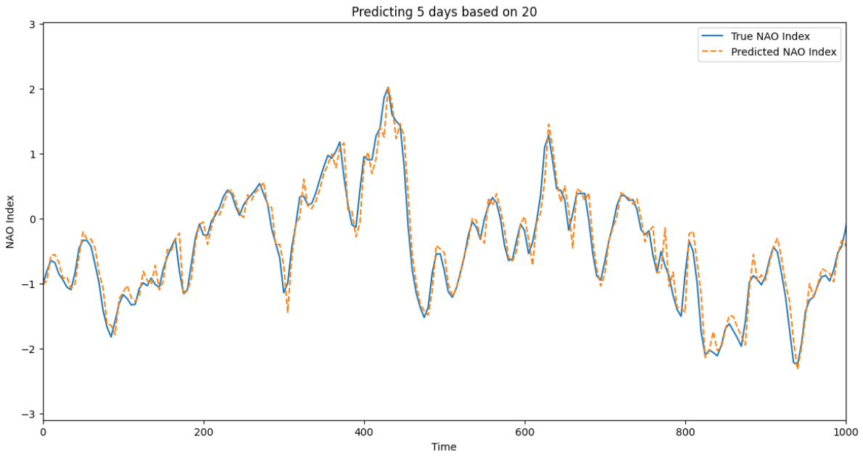
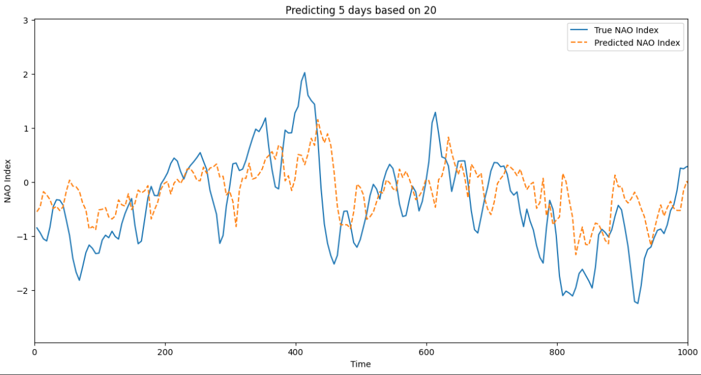
Extreme Learning Machine (ELM) with daily data
Day 1/5
Day 5/5

Slide 26
Model | Type | Finetuning | Normalization | Preprocessing | External TS | Frequency | Input length | Output length | MSE | Phase
XGBoost | ens_learning | None | True | None | None | Monthly | 24 | 1 | 3.85 | 38.35
XGBoost | ens_learning | None | True | EEMD | None | Monthly | 24 | 1 | 1.22 | 70.55
ELM | NN | 10 neurons | True | None | None | Monthly | 12 | 1 | 3.28 | 38.2
ELM | NN | 73 neurons | True | None | El Nino Index | Monthly | 36 | 1 | 3.4 | 39.1
ELM | NN | 64 neurons | True | None | None | Daily | 14 | 1 | 0.045 | 91.7
ELM | NN | 128 neurons | True | None | None | Daily | 14 | 5 | 0.275 | 80.7
ELM | NN | 128 neurons | True | None | None | Daily | 62 | 14 | 0.51 | 76.4
ELM | NN | 128 neurons | True | None | None | Daily | 123 | 31 | 0.63 | 75.1
LSTM | RNN | 64 neurons | True | None | None | Daily | 48 | 1 | 0.48 | 91.3
LSTM | RNN | 64 neurons | True | None | None | Daily | 48 | 5 | 0.27 | 73.0
NBeats | NN | None | True | True | None | Daily | 24 | 1 | 0.013 | 99.90
NBeats | NN | None | True | True | None | Monthly | 24 | 1 | 0.158 | 99.78

Slide 27
Outlook
Verification of results
Comparing models more systematically (daily/monthly data, EEMD/no EEMD)
Combining the best models & methods
Using rolling forecast

Slide 28
References
Weather maps: https://www.wetter3.de/Archiv/
NAO index values: https://verstat.no/nao-index-daily-monthly-and-yearly-average/
Rühs, S., Oliver, E. C., Biastoch, A., Böning, C. W., Dowd, M., Getzlaff, K., ... & Myers, P. G. (2021). Changing spatial patterns of deep convection in the subpolar North Atlantic. Journal of Geophysical Research: Oceans, 126(7), e2021JC017245.
Scaife, A. A.; Arribas, A.; Blockley, E.; Brookshaw, A.; Clark, R. T.; Dunstone, N.; Eade, R.; Fereday, D.; Folland, C. K.; Gordon, M.; Hermanson, L.; Knight, J. R.; Lea, D. J.; MacLachlan, C.; Maidens, A.; Martin, M.; Peterson, A. K.; Smith, D.; Vellinga, M.; Wallace, E.; Waters, J.; Williams, A. (March 2014). "Skilful Long Range Prediction of European and North American Winters". Geophysical Research Letters. 41 (7): 2514–2519. Bibcode:2014GeoRL..41.2514S. doi:10.1002/2014GL059637. hdl:10871/34601. S2CID 127165980.
Data: https://www.cpc.ncep.noaa.gov/products/precip/CWlink/pna/nao.shtml

